Slide 1
US Wildfire Behavior Over Time
Team Members:
Michael Turnell
Suparna Bhattacharjee

Slide 2
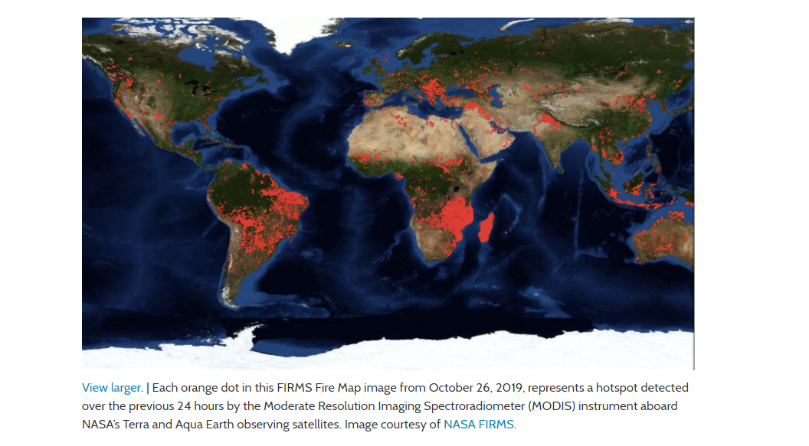
1. Frequent fire incidence occurrences around the globe 2. Climate change 3. Impact on and by Humans
INSPIRATION
Is Earth on Fire?
Picture 1
-Analyzing wildfire occurrences across US from 2000-2015, and study the trend, cause and impact on weather, humans and vice-versa.

Slide 3
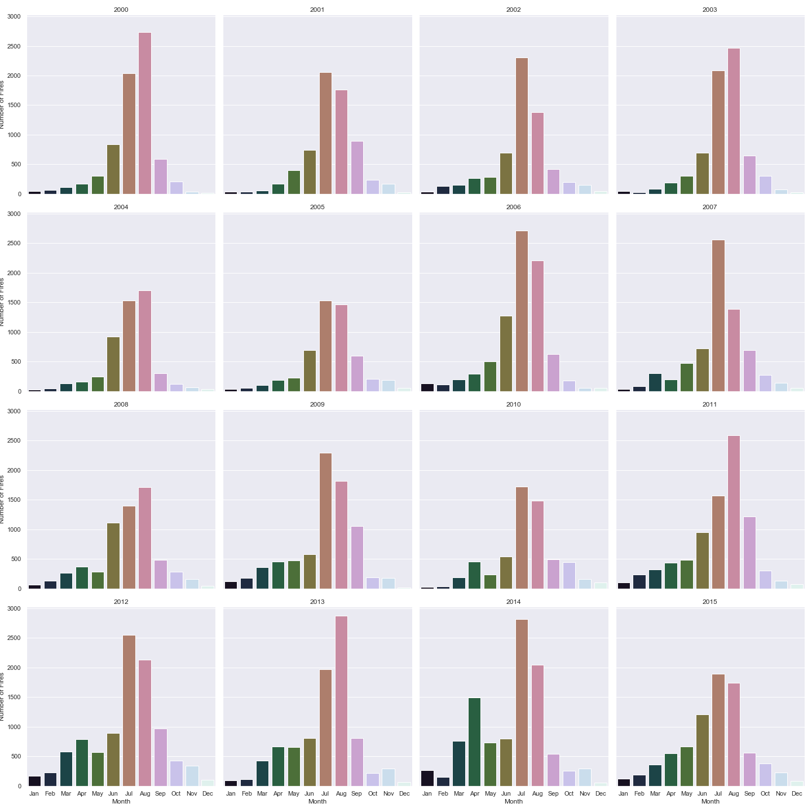
Wildfire Trend – 2000-2015 by month

Slide 4
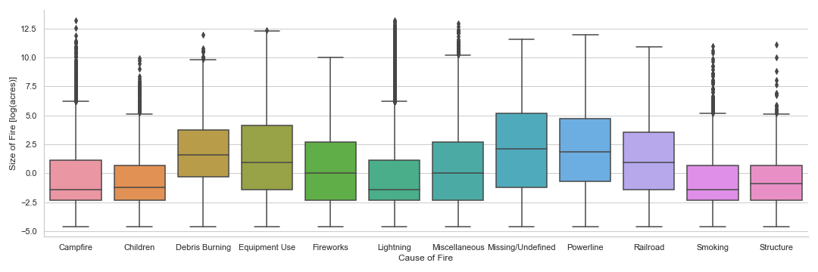
QUESTION AND DATA
HOW DOES THE CAUSE OF FIRE AFFECT THE FIRE SIZE?

Slide 5
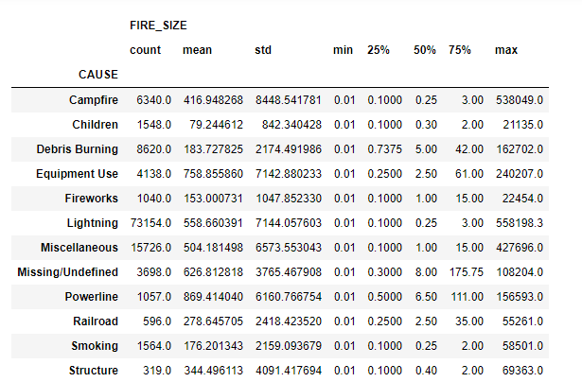
ANALYSIS
f-test p-value: 6.01e-07
Kruskal p-value: Too small to calculate (~=0)
Paired t-testing results:
Children - Equipment Use
Debris Burning - Equipment Use
Debris Burning – Lightning
Debris Burning – Miscellaneous
Debris Burning - Missing/Undefined

Slide 6
QUESTION AND DATA
HOW DOES THE GEOGRAPHIC DISTRIBUTION
OF FIRES CHANGE OVER TIME?

Slide 7
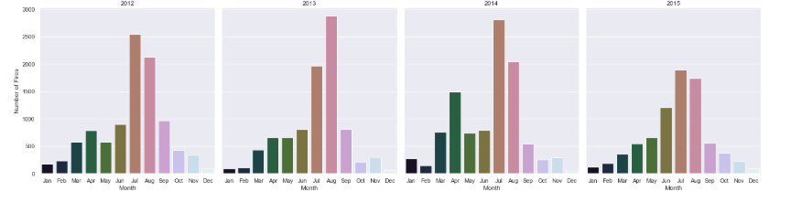
QUESTION AND DATA
DOES THE SEASON/TIME OF YEAR HAVE AN AFFECT ON THE NUMBER OF FIRES?

Slide 8
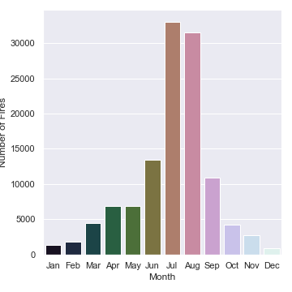
ANALYSIS
Critical Value: 19.67513757268249
Chi-squared test p-value:
Too small to calculate (~=0)

Slide 9
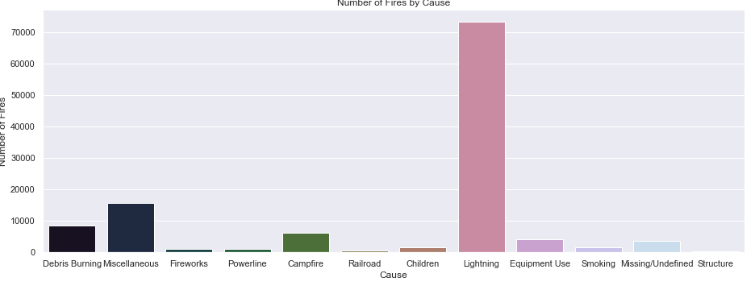
QUESTION AND DATA
Critical Value: 19.67513757268249
Chi-squared test p-value:
Too small to calculate (~=0)
ARE FIRES EFFECTIVELY OR RANDOMLY CAUSED OR IS ONE CAUSE MORE LIKELY THAN THE OTHERS?

Slide 10

1. Spatial Merging of the wildfire dataset with the weather data. 2. Data set being too large. 3. Challenges in analyzing the dataset.
LIMITATIONS AND CHALLENGES
Picture 2

Slide 11
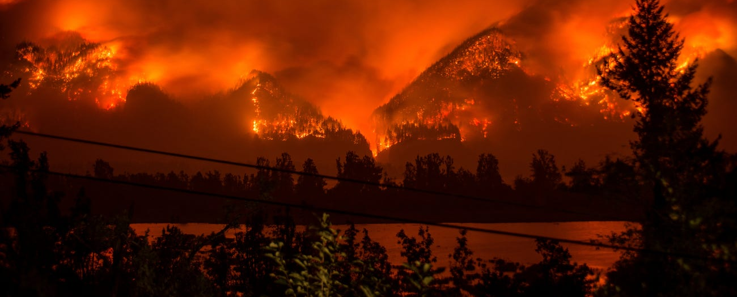
CONCLUSION
Picture 3
1. The most number of significant fire sizes have been caused due to Debris Burning.
2. Summer, ideally from July through August, these two months , we have noticed the maximum number of fire occurrences.
3. Lightning has been observed as the most common reason of fire cause.
4. Geographic distribution of fire stays mostly the same over time.

Slide 12
References:
1. Wildfire Dataset: https://www.kaggle.com/rtatman/188-million-us-wildfires
2. Weather Dataset: ftp://ftp.ncdc.noaa.gov/pub/data/ghcn/daily/superghcnd/
3. Picture References on the Slide:
Picture 1 on Slide 2- https://firms.modaps.eosdis.nasa.gov/map/#z:3;c:0.0,0.0;d:2019-11-14..2019-11-15
Picture 2 on Slide 10 - https://en-author-services.edanzgroup.com/blogs/how-write-about-your-study-limitations-without-limiting-your-impact
Picture 3 on Slide 11 - https://www.businessinsider.com/wildfire-season-western-us-2017-9

